Slide 1

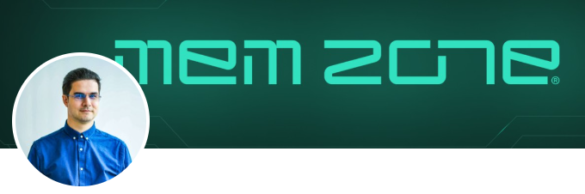
Tips and Tricks with Intune onboarding
Co-Founder MEM Zone
LinkedIn – vilcu.paul
X @vidockq
MEM Zone Blog
www.mem.zone/latest/

Slide 2

Join the Community > Learn > Help > Improve > Share
International Community (constantly growing)
LinkedIn
Microsoft Mac Admins
Modern Endpoint Management (SCCM | Intune | W365 | AVD | Security | macOS | iOS )
X
Teach the algo your preferences.
Search Tags #intune #PowerShell #MEM #SCCM #CfgMgr #ConfigMgr #azure
Discord
Microsoft EMS Community
Win Admins
Reddit
Intune: Mobile Device Management (reddit.com)

Slide 3
Join the Community > Learn > Help > Improve > Share
International Community (constantly growing)
Must Read Blogs:
MEM.Zone | Latest
Blog Archives - Patch My PC
Microsoft Intune & SCCM Blog - System Center Dudes
Syst & Deploy (systanddeploy.com)
Simon does Microsoft 365, Intune, Azure, Entra and Security (skotheimsvik.no)
Home - Call4Cloud - Intune | MMP-C | WinDC | Autopilot Everything about Microsoft 365 and Intune
Modern IT – Cloud – Workplace – Enterprise Mobility and the Microsoft Cloud (oliverkieselbach.com)
Github
Repo search for keywords
Microsoft Learn

Slide 4
Tips and Tricks with Intune onboarding
Agenda:
Microsoft Intune and EntraID.
Microsoft Intune supported OS and Methods (Company Owned Resouces only)
Windows
macOS
Linux

Slide 5
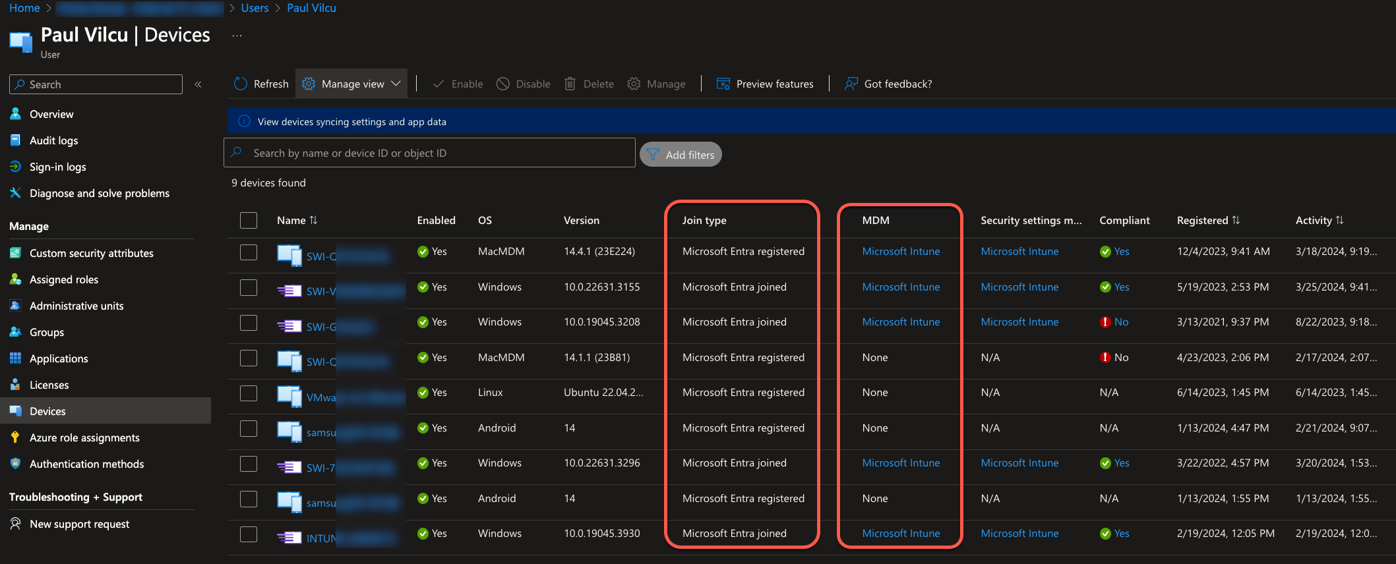
Microsoft Intune and EntraID.
Different services.
The importance of spotting and understanding Join Type and Objects

Slide 6
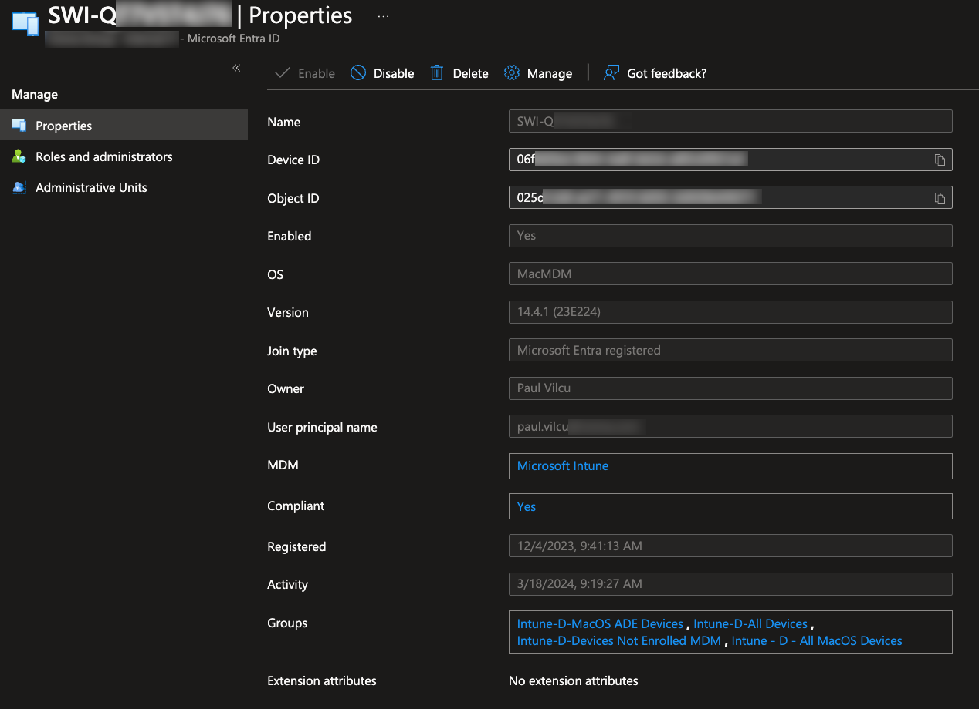
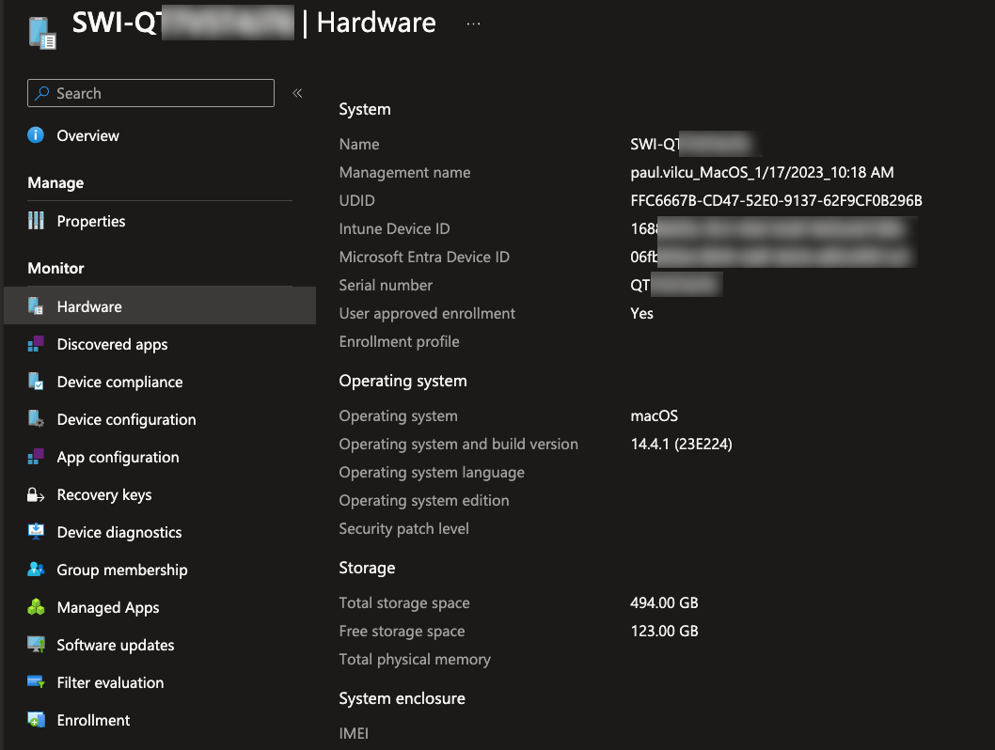
Microsoft Intune and EntraID.
Entra ID: Object ID and Device ID
Intune:
Intune Device ID
Entra Device ID
Important in Troubleshooting scenarios

Slide 7
Microsoft Intune and EntraID.
Different services.
The importance of spotting and understanding Join Type and Objects

Slide 8
Microsoft Intune supported OS and Methods.
Windows OS
Autopilot
Hybrid Join
Entra Joined
macOS
Automated Device Enrollment (ADE) / Apple Business Manager (ABM)
Direct Enrollment: Company Portal
Entra Registered
Linux
Agent Based
Entra Registered

Slide 9
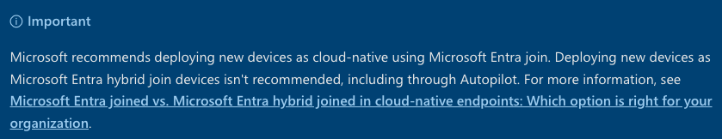
Windows OS
Hybrid Join
Avoid if possible.
Go Clean > Full Cloud Join > Entra Joined only.
Transitory technology to get companies to onboard.
Requires in-depth knowledge of ConfigMgr > AD > Intune
Can have 3 systems battling for supremacy.
Troubleshooting this is a nightmare.

Slide 10
Windows OS
Microsoft Entra Joined
Full cloud solution.
Integrates perfectly with Windows Update for Business aka Windows Autopatch.
Device will be in Workgroup.
FAQ from on-prem users
Network Shares
Custom Solutions
Printers
Universal Print
RDP
Rules, Firewall, Training
DNS
Configuration Profiles
DNS Suffix Search List
Carefull for number.

Slide 11
Windows OS
Microsoft Entra Joined with Autopilot
Microsoft:
You can use Windows Autopilot to reset, repurpose, and recover devices.
This solution enables an IT department to achieve these goals with little to no infrastructure to manage, with a process that's easy and simple.
Think of it as cloud deployment of Windows.

Slide 12
Windows OS - Autopilot
Creates a link between the Hardware and your Azure Tenant.
Can be used from ConfigMgr > Reports / CMPivot or JSON Config
Using PowerShell PowerShell Gallery | Get-WindowsAutoPilotInfo 3.9
.csv file that needs to be uploaded manually.
Autopilot & The Perceived Tenant Security Risk - MSEndpointMgr
Key change with the –online parameter.
Microsoft bolstered the security level of –online, leaving room only for Gas
This presents a big problem for spread offices.
MS-Graph to the rescue
Microsoft Application > Grant MS-Graph Rights > Automation Account if needed

Slide 13

Windows OS - Autopilot
IntuneMyDevice Tool
IntuneMyDevice Tutorial (youtube.com)
Will soon be available on MEM.Zone | Latest

Slide 14
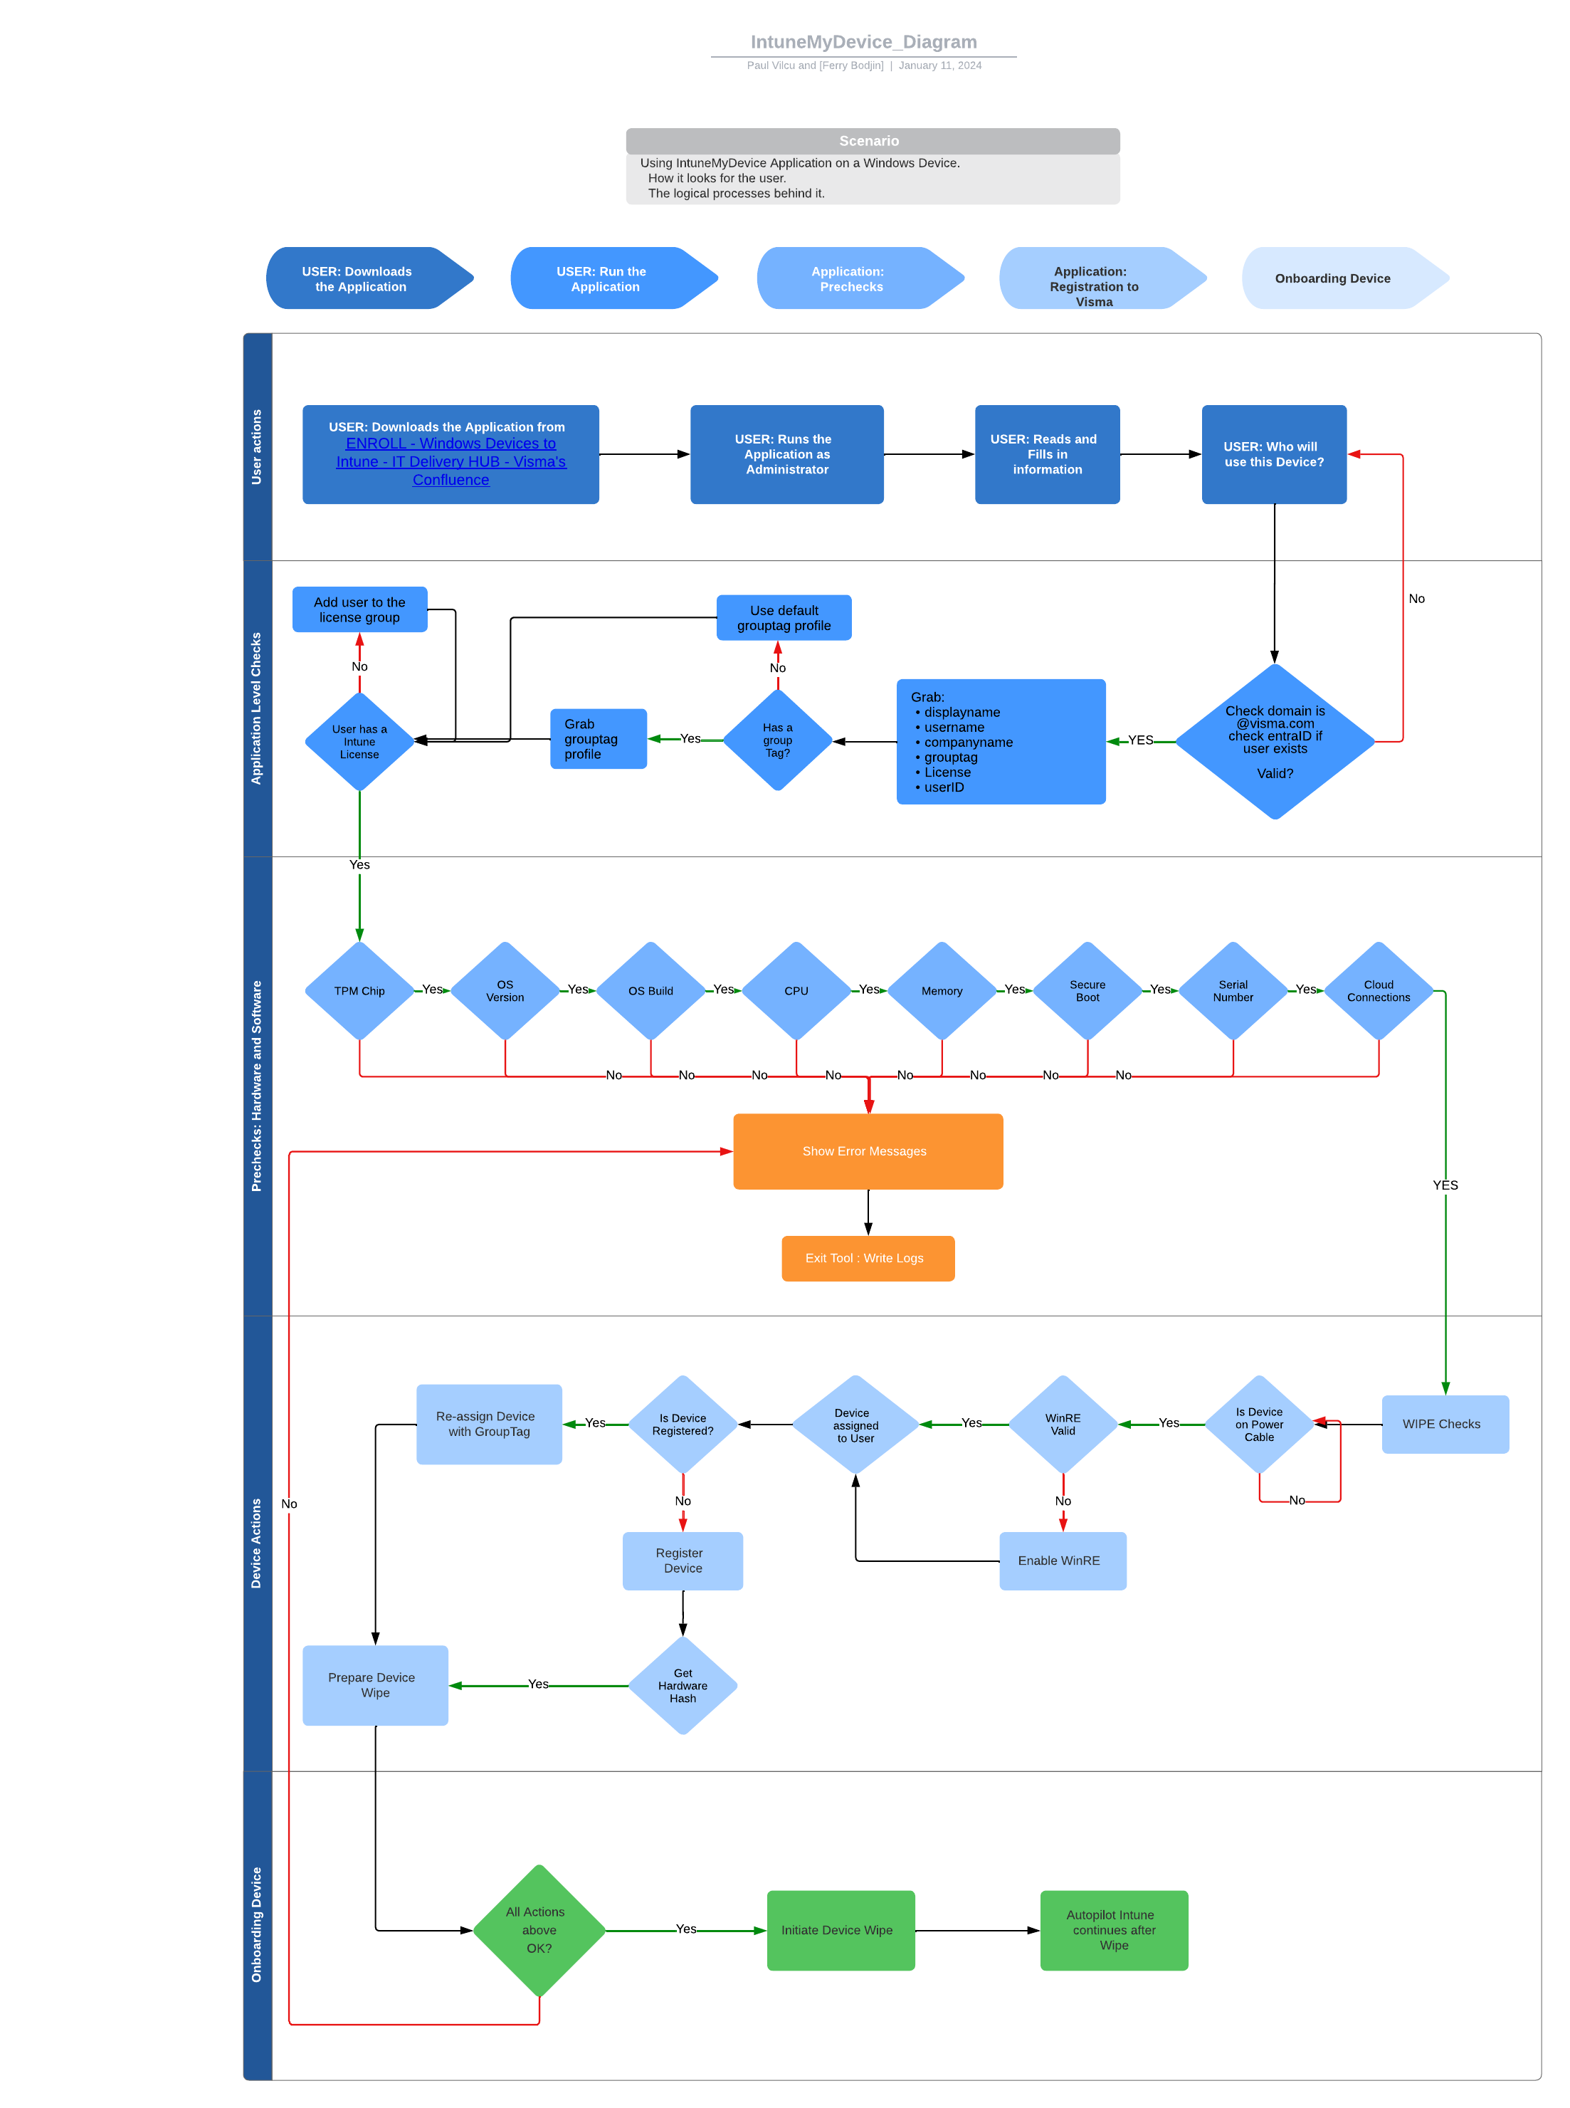
Windows OS - Autopilot
Start small and build your way up.
See what community built and integrate.
One step at a time.

Slide 15
macOS
Automated Device Enrollment (ADE) / Apple Business Manager (ABM)
The Apple equivalent to Autopilot.
Devices are registered in Apple Business Manager Portal >>> Sync to Intune Portal
Flags the device as Company Property
Gives unique advantages:
File vault Key Enforcement
Key difference versus Direct Enrollment
Access to device even if personal iCloud is set.
Can bypass security measures set by the user.
Coming soon, SSO possibilities.
Declarative Device Management - DDM Configurations
Security Updates Configurations
Proffered method for company resources.

Slide 16
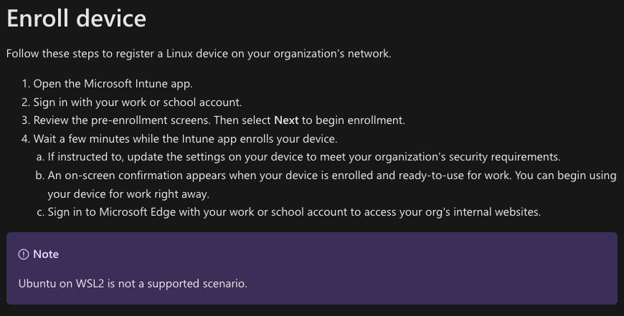
Linux – Ubuntu Flavor
The Microsoft forgotten OS.
The least supported platform.
Minimal configurations.
Be careful of Encryption!
Compliance Policies and Scripts!
These 2 are the saving grace for Linux in terms of management.
Compliance Policies Script that uses JSON export
Tutorial | Microsoft Intune for Ubuntu (youtube.com)
Great example
Scripts: Bash
Notable mention that some scripts will not execute with full rights.
Notable mention that

Slide 17
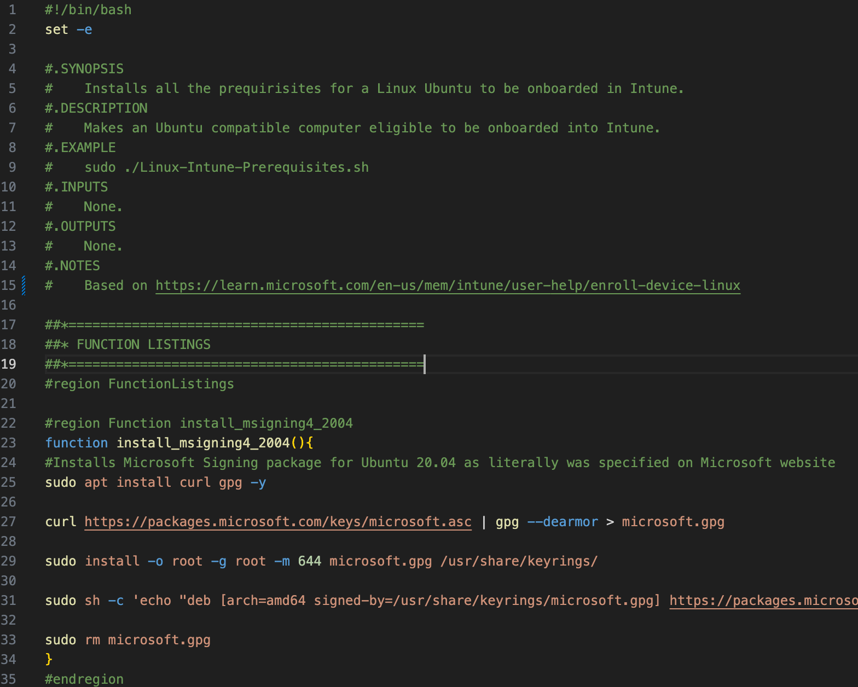
Linux – Ubuntu Flavor
Notable mention that
Script for onboarding:

Slide 18
Thank you!

